Slide 1

CMPT 413/713: Natural Language Processing
Transformers and Self-Attention
Zhiyun (Richard) Peng
2026-10-28
Adapted from slides from Angel Chang, Anoop Sarkar, Danqi Chen, Karthik Narasimhan, and Justin Johnson, Chris Manning, Abigail See, Andrej Karpathy, Graham Neubig
Notes:
http://demo.clab.cs.cmu.edu/NLP/

Slide 2
Review of attention in sequence to sequence models

Slide 3
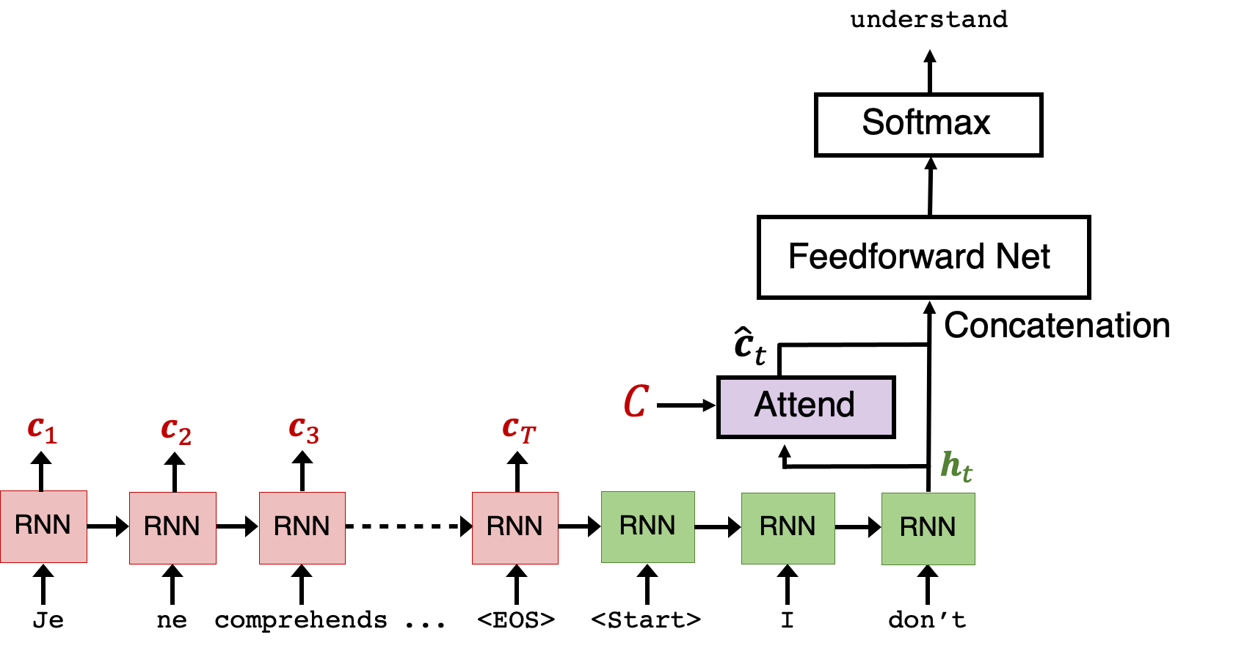
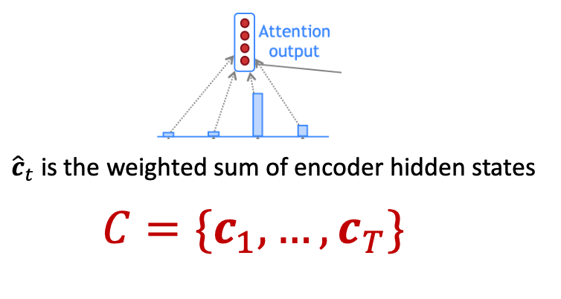
Attentive machine translation summary
(slide credit: Peter Anderson)

Slide 4
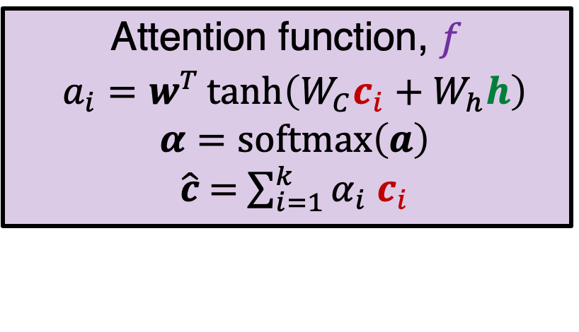

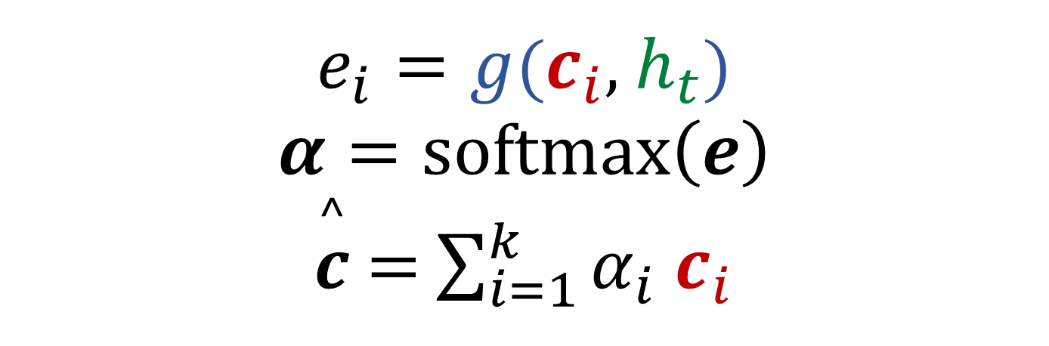
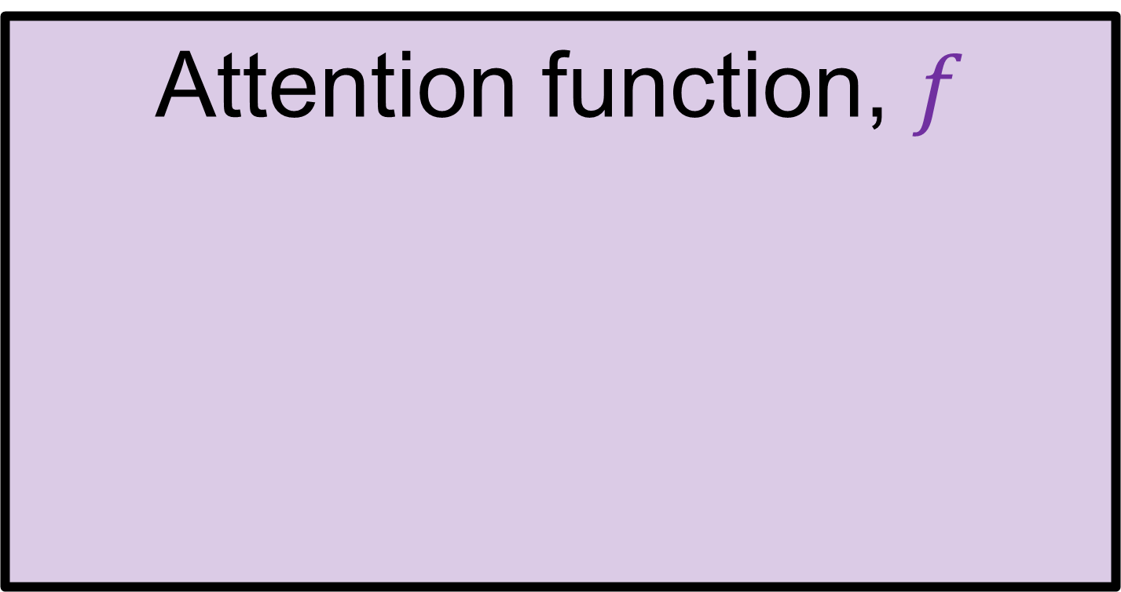
Attentive machine translation summary
Attention function, $f$
$e_{i}=g$($c_{i}$, $h_{t}$)
$$α=softmax\left(e\right)$$
$\overset{^}{c}$ $=$ $\sum_{i=1}^{k}{α_{i}}$ $c_{i}$
(slide credit: Peter Anderson)

Slide 5

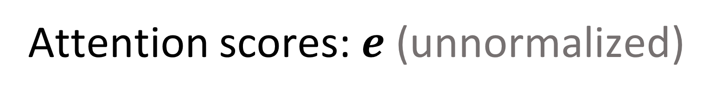
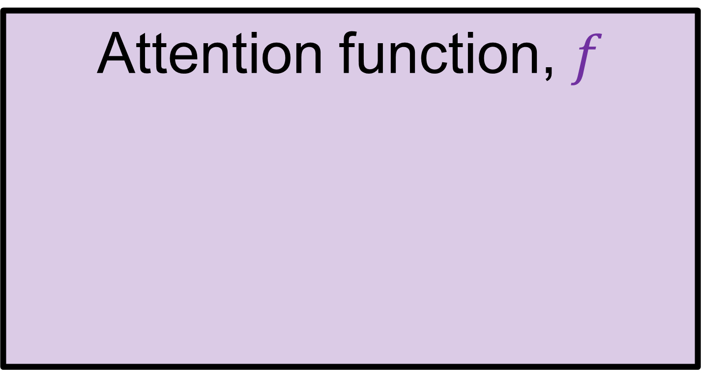
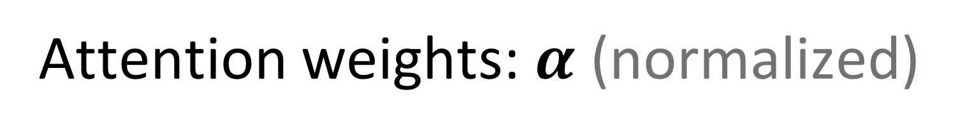
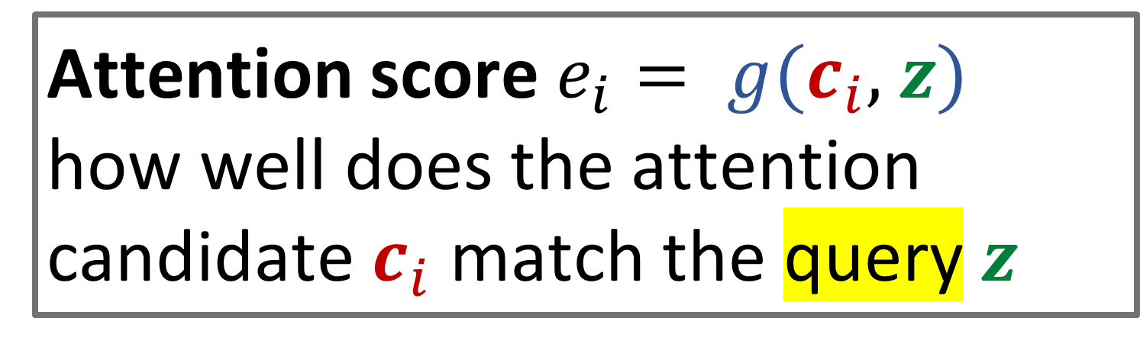
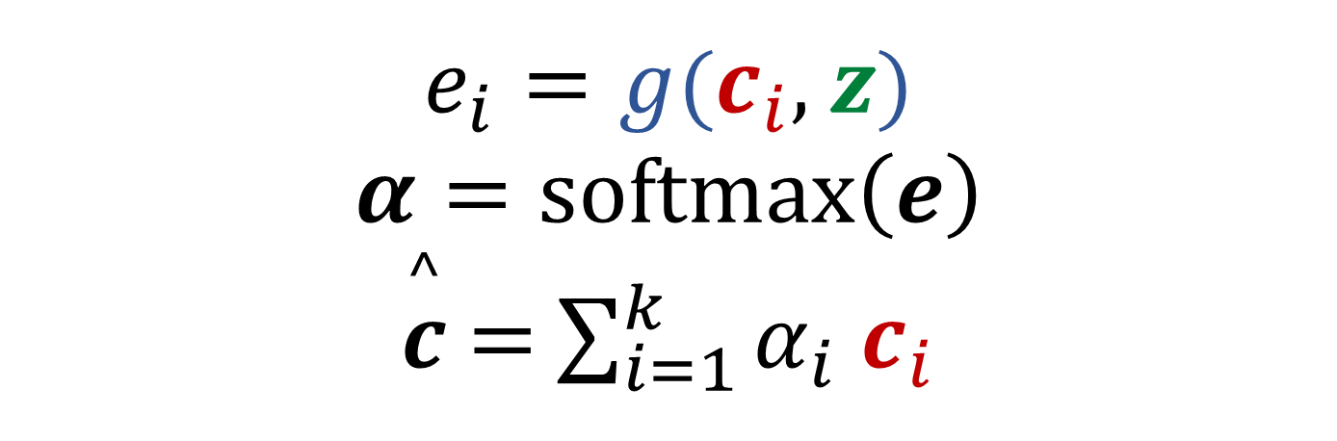
Summary of attention
Attention function, $f$
Attention scores:$e$ (unnormalized)
$e_{i}=g$($c_{i}$, $z$)
$$α=softmax\left(e\right)$$
$\overset{^}{c}$ $=$ $\sum_{i=1}^{k}{α_{i}}$ $c_{i}$
Attention weights: $α$ (normalized)
Final attention output
Weighted sum of context features
(or values)
Dot-product attention:
Neural network
Attention score $e_{i}= g$($c_{i}$, $z$)
how well does the attention candidate $c_{i}$ match the query $z$

Slide 6
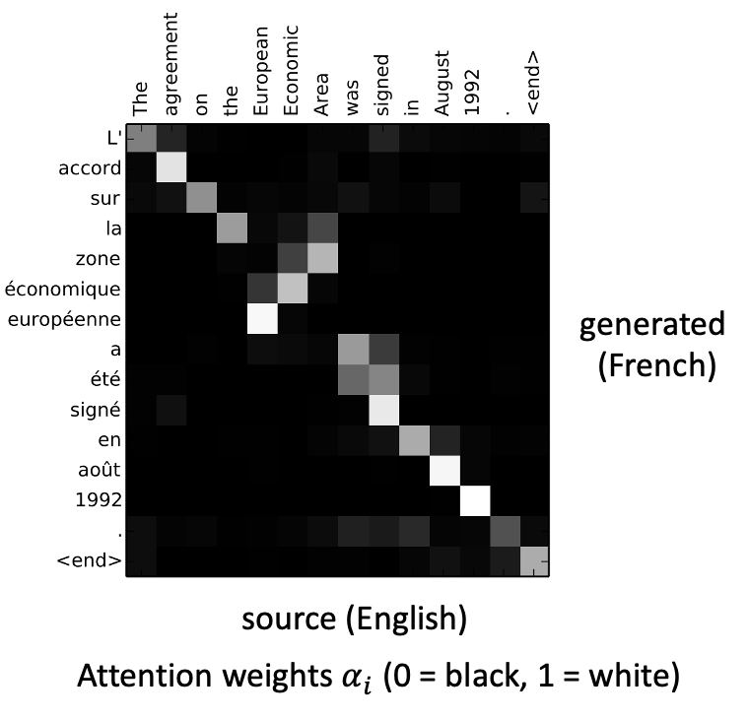
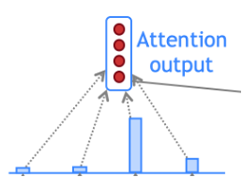
Motivation of attention
How much does this attention candidate match the query vector?
Motivated by biological attention and alignment in machine translation
get a representation that is a weighted sum over the attention candidates based on a query vector
the
agreement
on
the

Slide 7
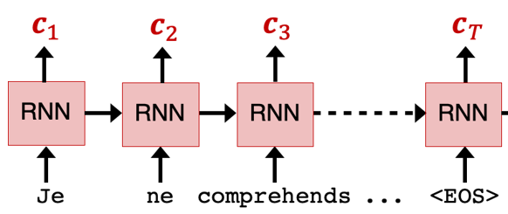
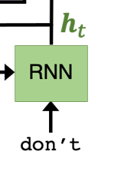
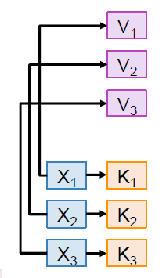



Attention is a general deep learning technique
In P4
In P4
  Given a set of value vectors and a query vector, attention is a way to compute a weighted sum of the values dependent on the query.
    The query determines what values to focus on,
      We say: the query “attends” to the values
    In NMT, each decoder hidden state (query) attends to all the encoder hidden state (values)
  A more general form: use a set of keys and values
    The keys are used to compute the attention scores
    The values are used to compute the output vector

Slide 8
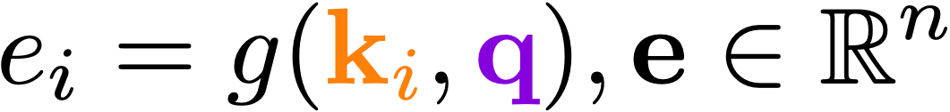
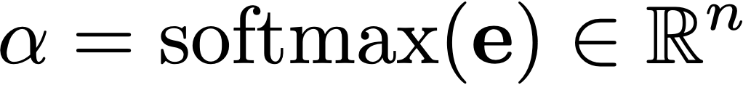
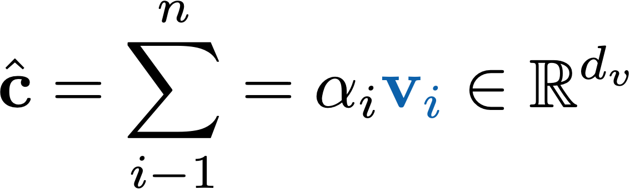
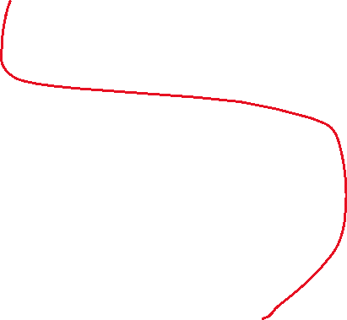
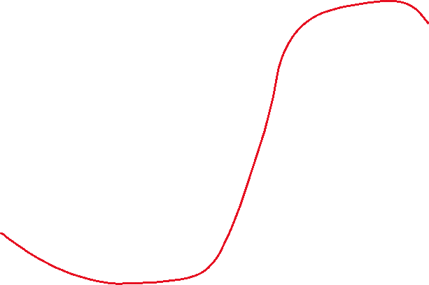
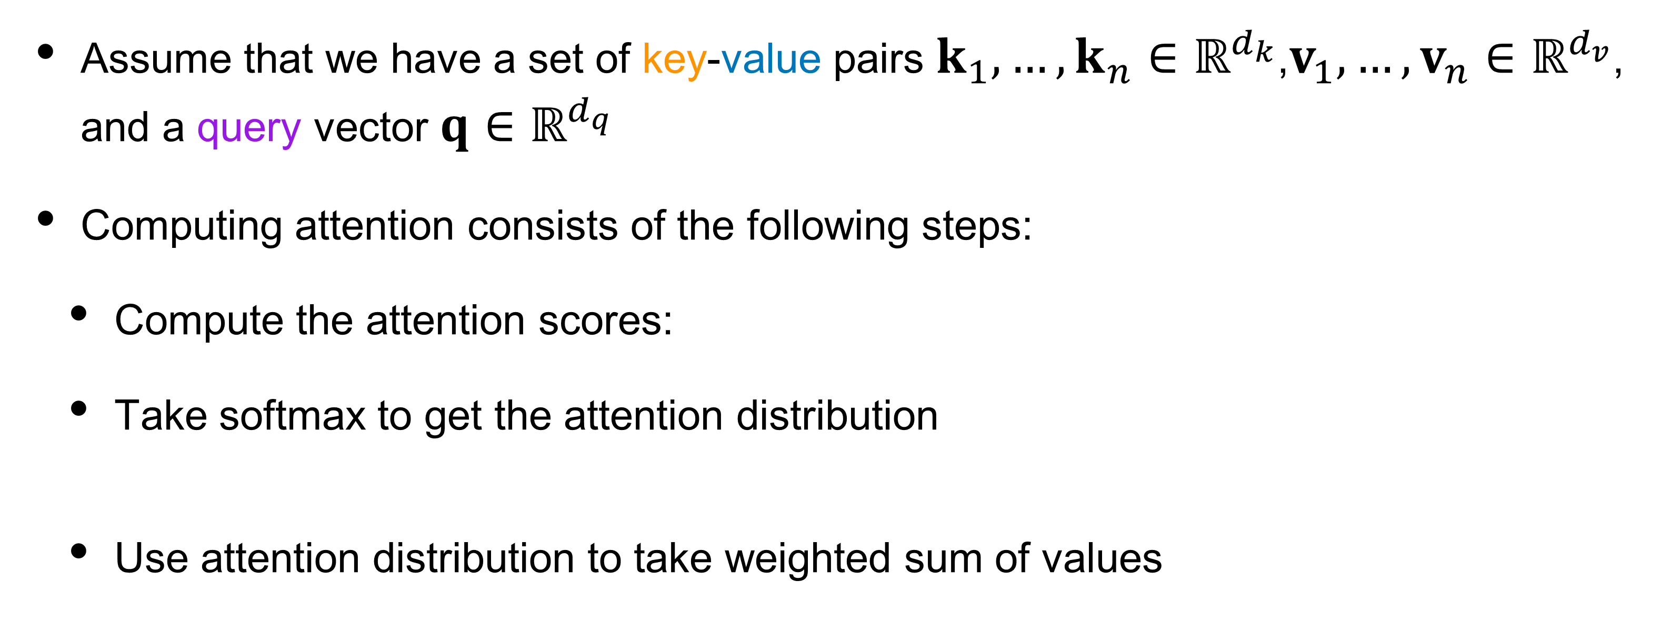


Attention is always computed the same way
Assume that we have a set of key-value pairs $k_{1},…,k_{n}∈ℝ^{d_{k}}$,$v_{1},…,v_{n}∈ℝ^{d_{v}}$, and a query vector $q∈ℝ^{d_{q}}$
Computing attention consists of the following steps:
  Compute the attention scores:
  Take softmax to get the attention distribution
  Use attention distribution to take weighted sum of values

Slide 9
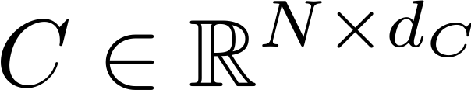
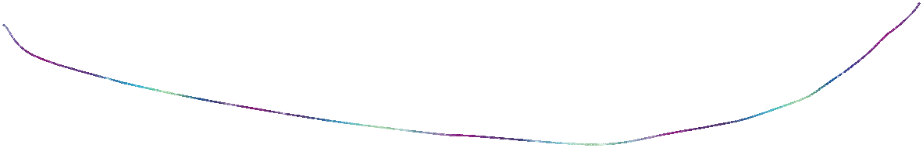
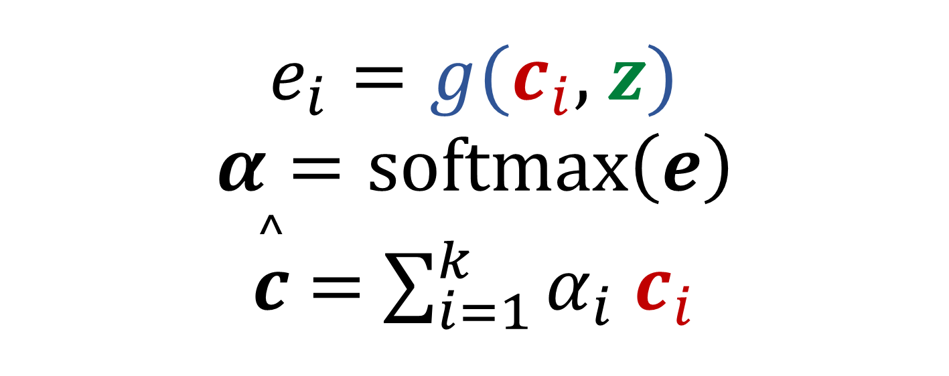
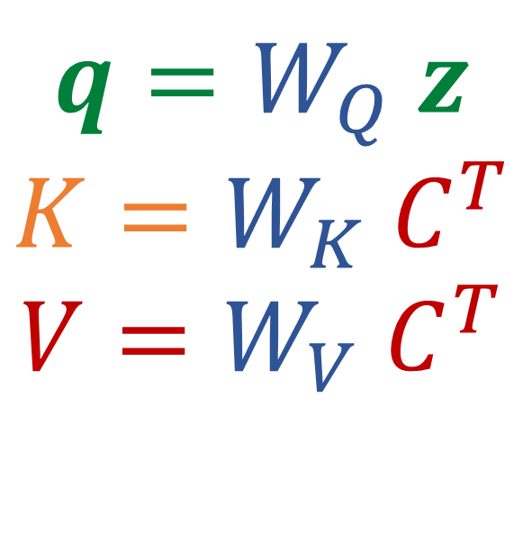
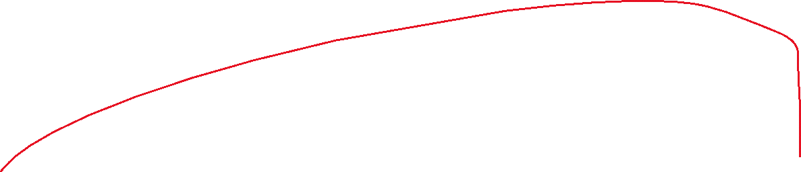
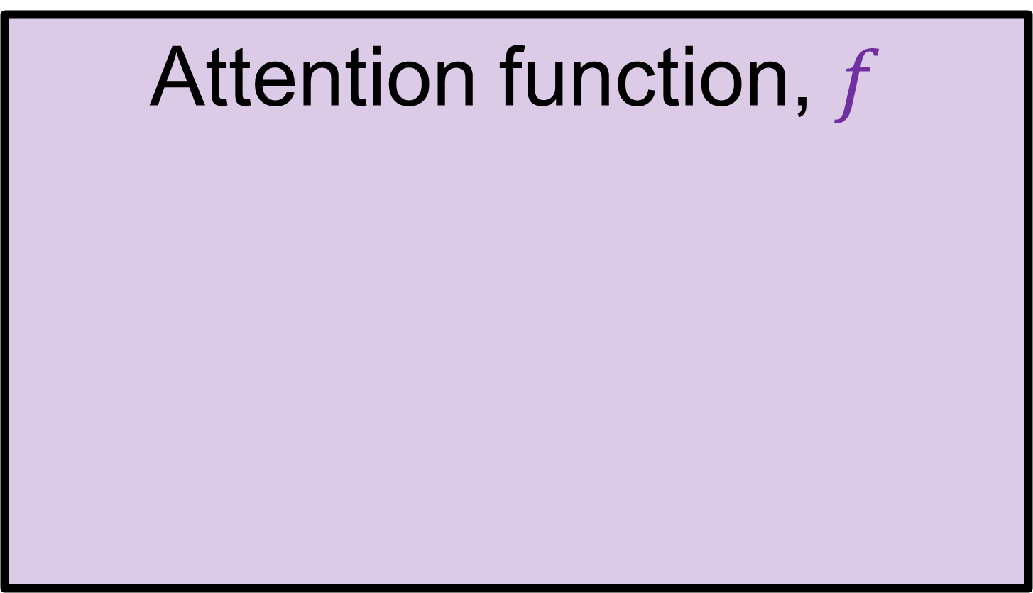
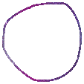

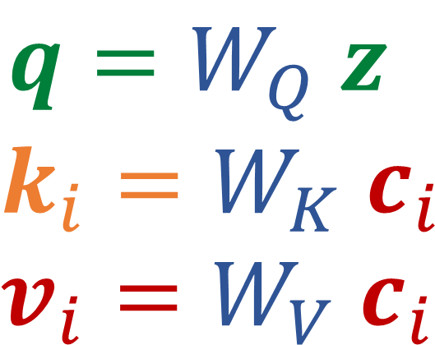
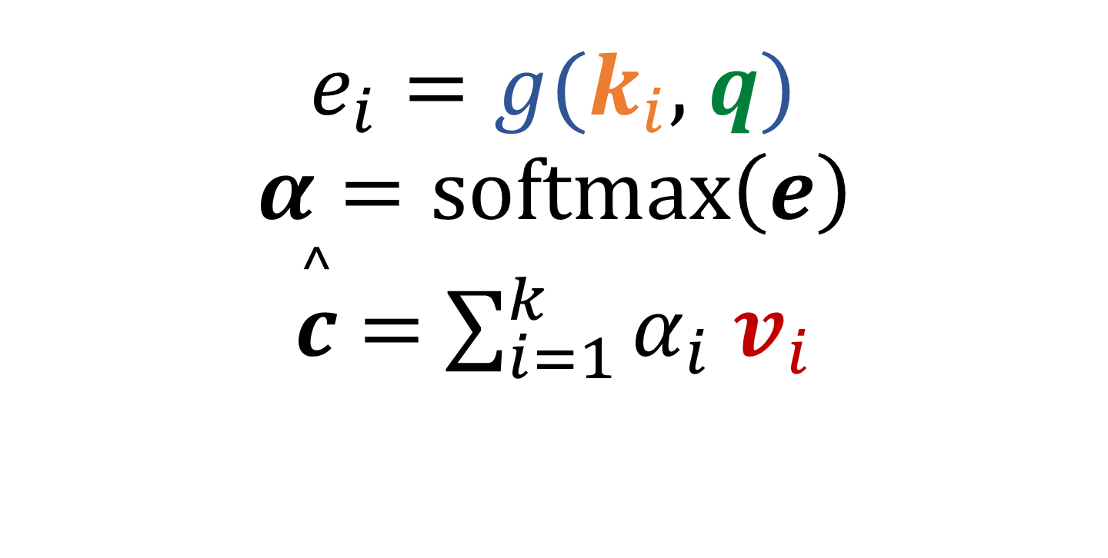

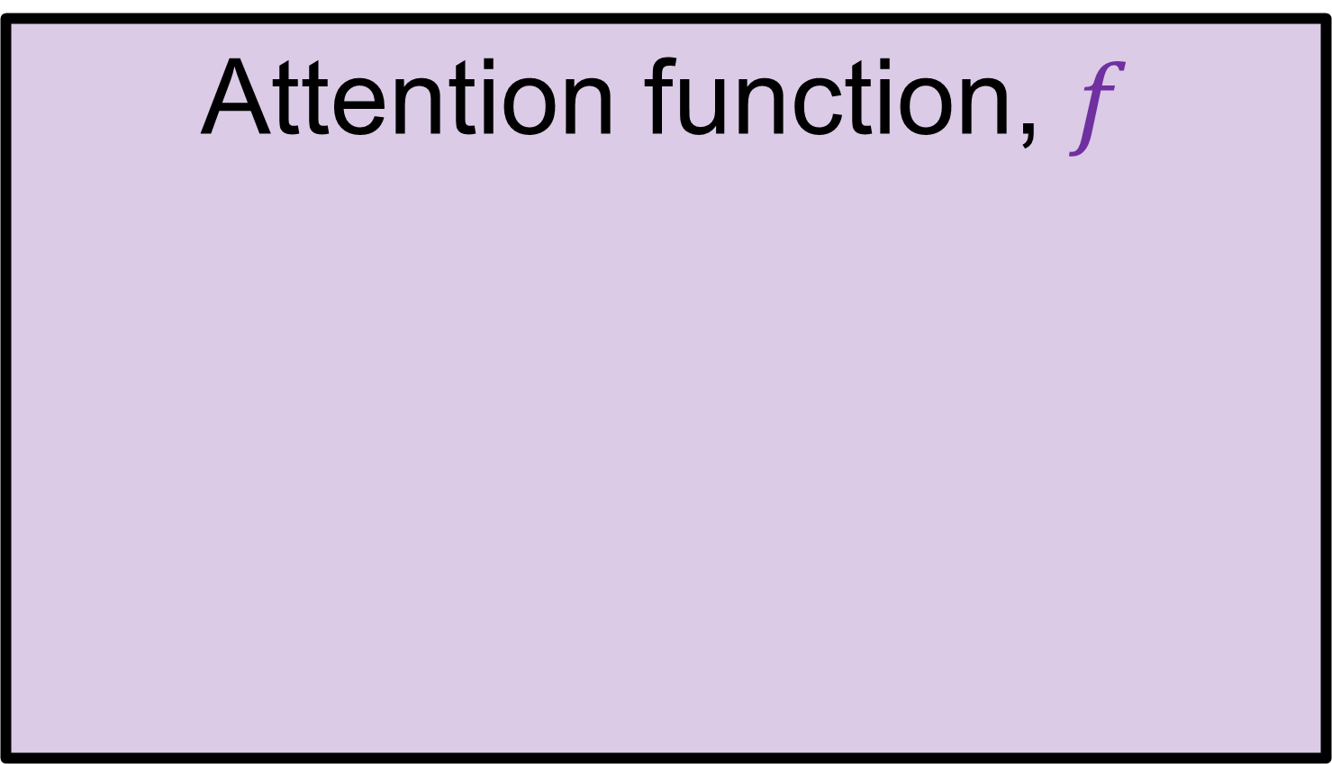
Query-Value-Key view of attention
Attention function, $f$
Attention function, $f$
$e_{i}=g$($c_{i}$, $z$)
$$α=softmax\left(e\right)$$
$\overset{^}{c}$ $=$ $\sum_{i=1}^{k}{α_{i}}$ $c_{i}$
$e_{i}=g$($k_{i}$, $q$)
$$α=softmax\left(e\right)$$
$\overset{^}{c}$ $=$ $\sum_{i=1}^{k}{α_{i}}$ $v_{i}$
Matrix form
$q=W_{Q}$ $z$
$$k_{i}=W_{K}{ c}_{i}$$
$$v_{i}=W_{V}{ c}_{i}$$
$q=W_{Q}$ $z$
$$K=W_{K} C^{T}$$
$$V=W_{V} C^{T}$$
Projected query,key,value

Slide 10
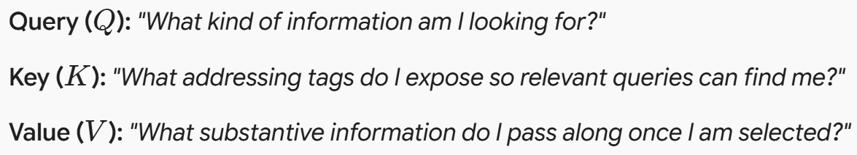
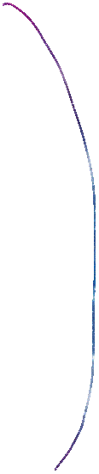
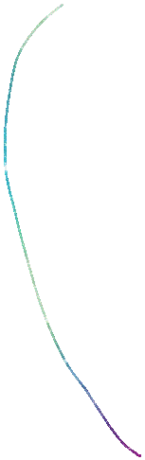



General form of attention: key-value-query
Attention is a way to compute a weighted sum of the values dependent on the query and the corresponding keys.
  All of these (key value query) are represented using vectors
    The query and key are used for addressing (contains partial information). While the values provide more complete information
    The weighted sum is a selective summary of the information found in the values.
    It is a way to obtain a fixed-sized representation of an arbitrary set of representations (values) based on some other representation (the query)
i.e., locating, indexing

Slide 11
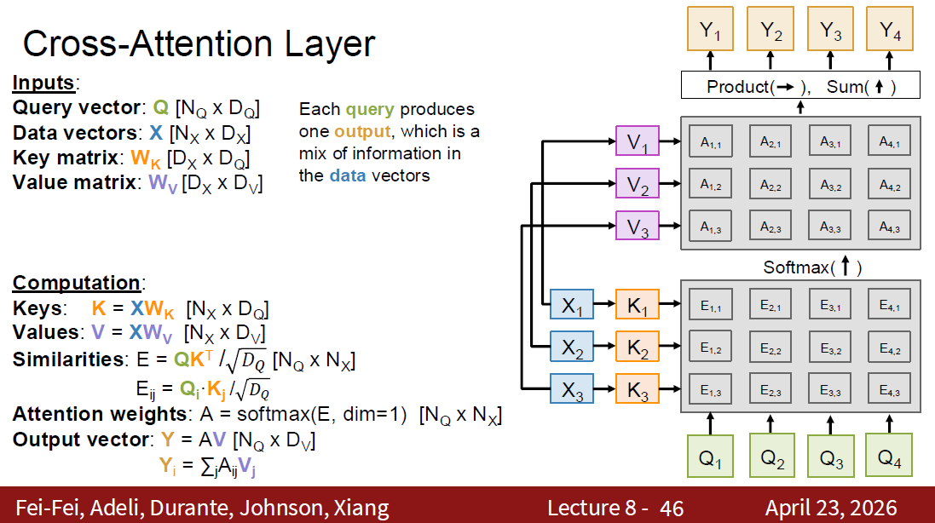
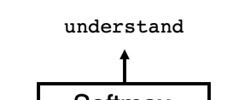
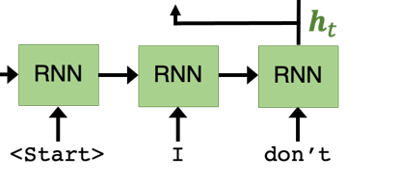







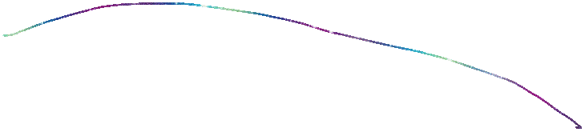


In P4
In P4
In P4
slide credit:

Slide 12
Transformers

Slide 13
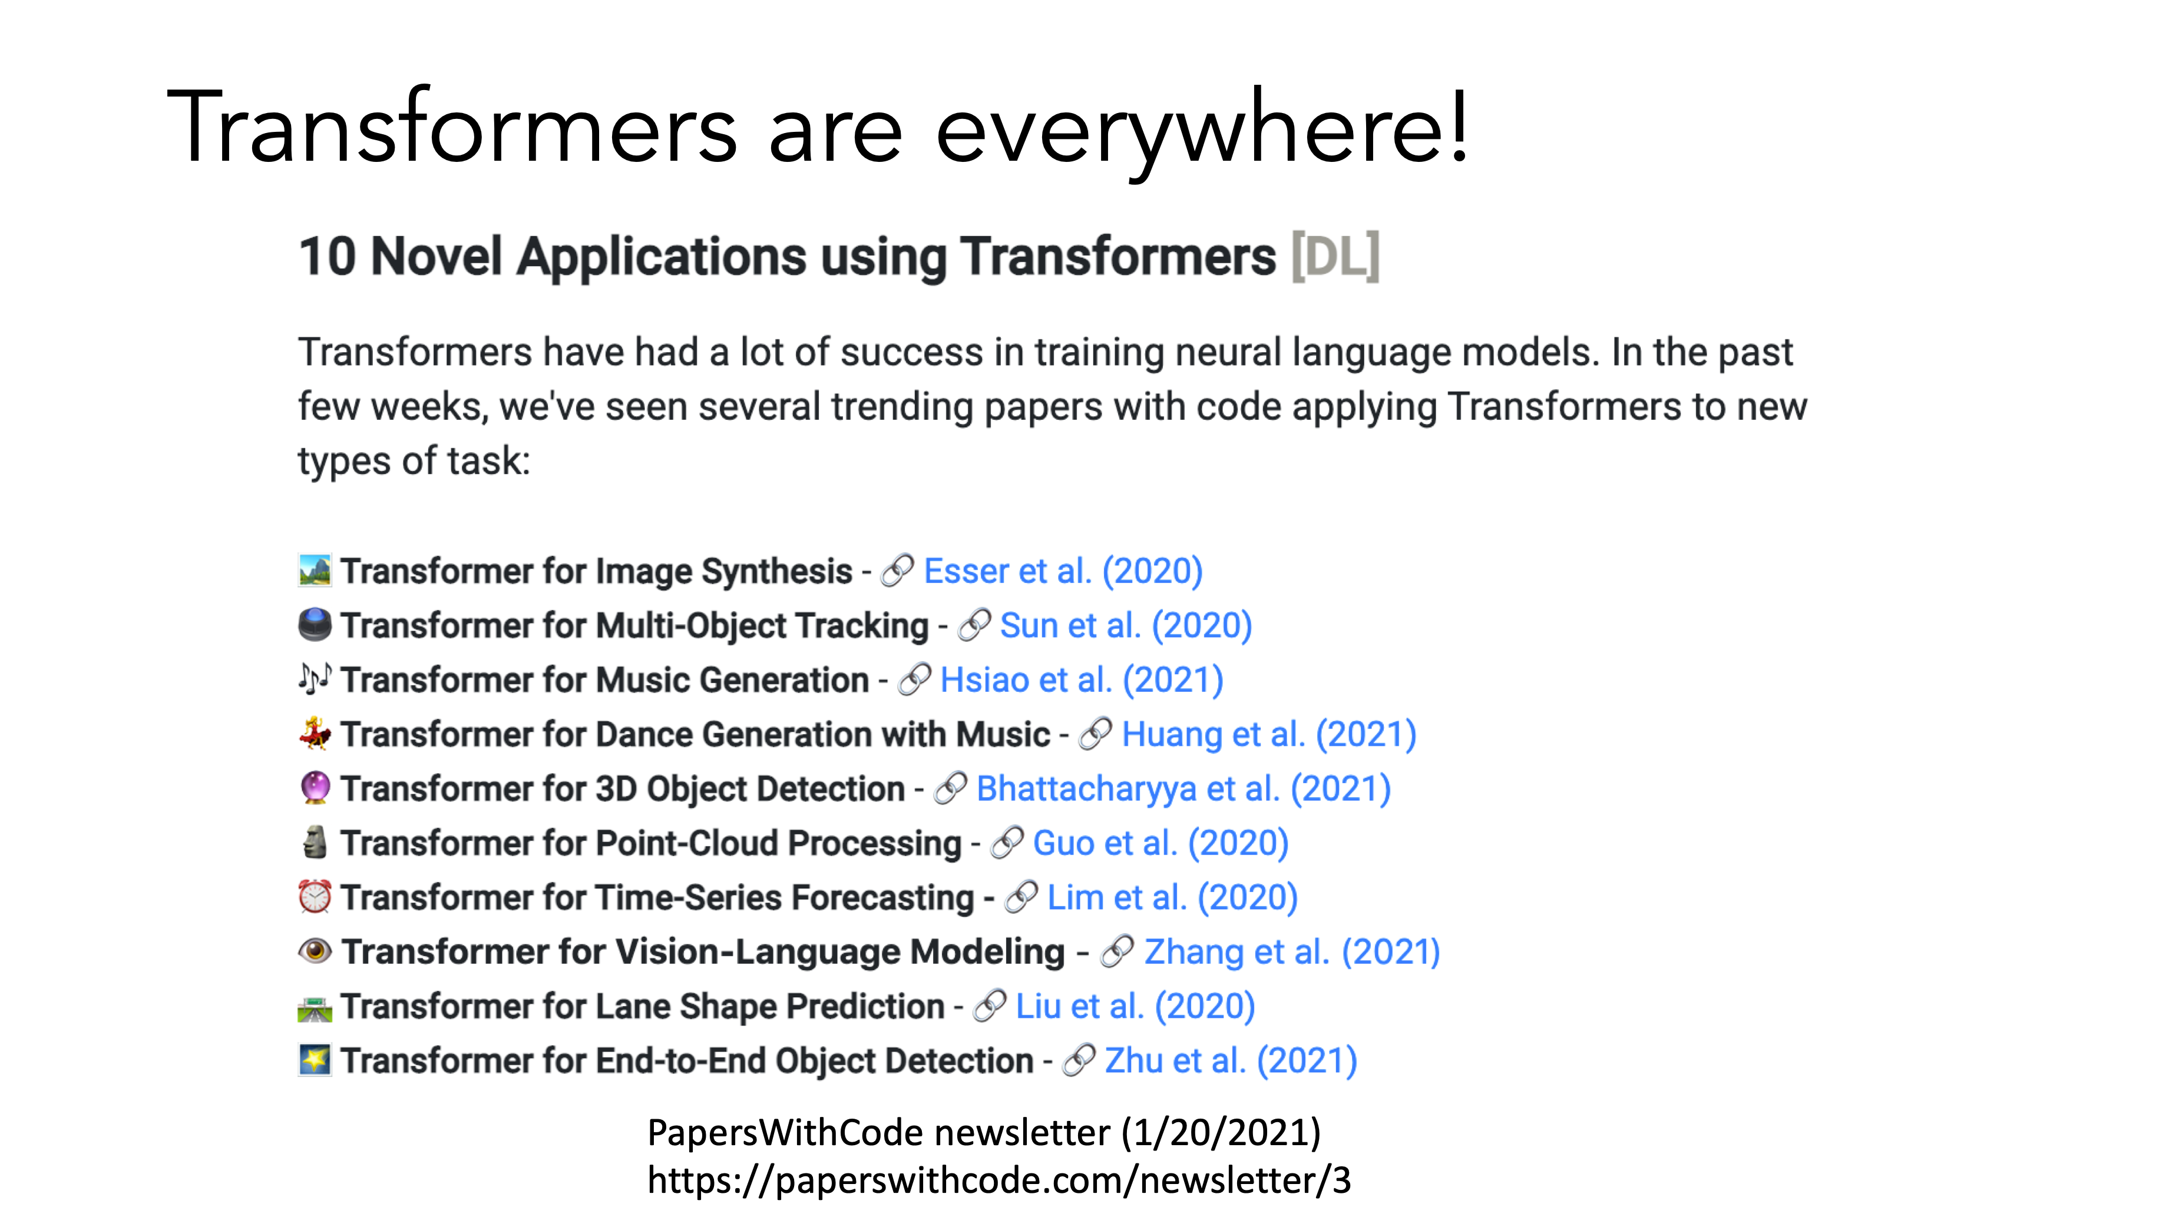
Z

Slide 14
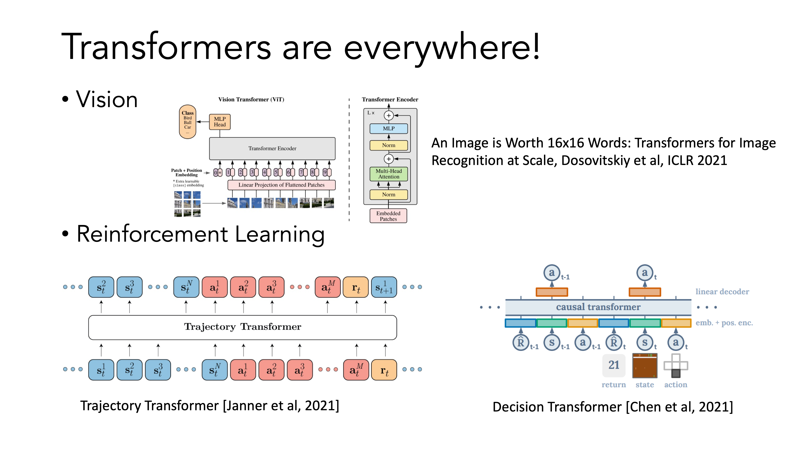

Slide 15
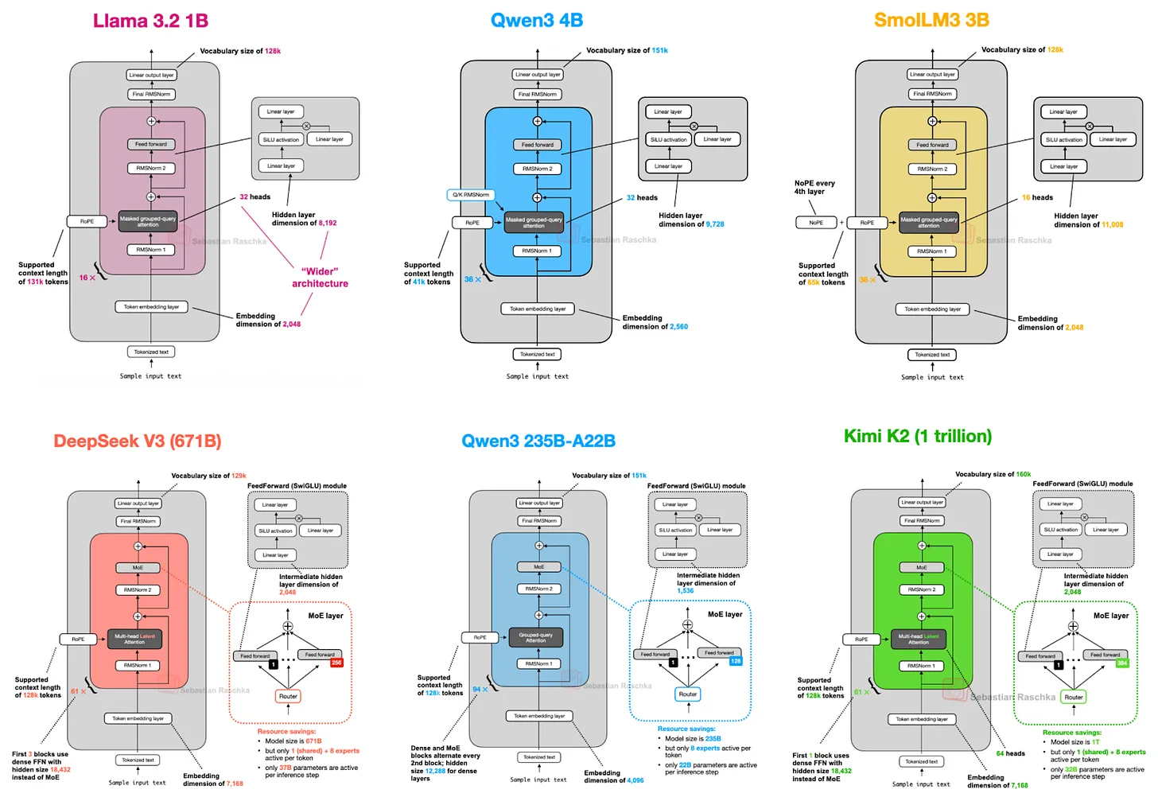
Transformers are the basis of modern LLMs
https://magazine.sebastianraschka.com/p/the-big-llm-architecture-comparison

Slide 16
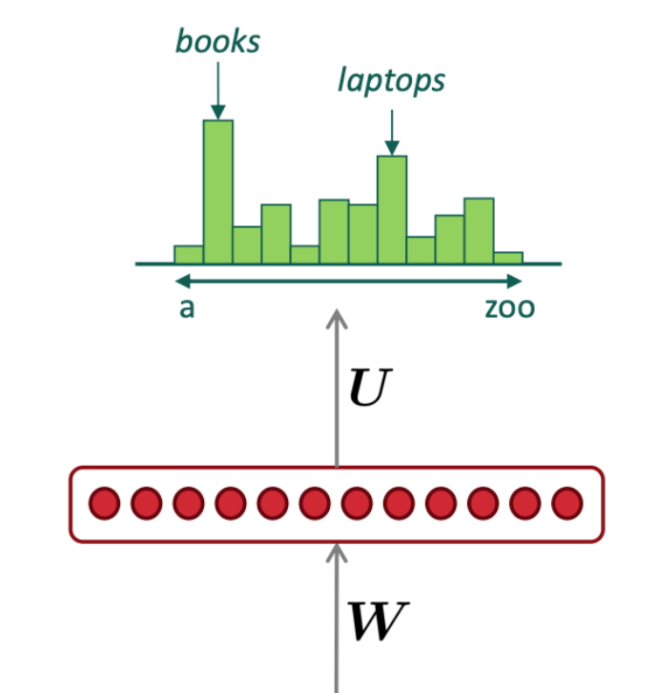
Transformers for Language Modeling
Transformer
Self-attention neural module that transforms
token representation via many layers
SOS
the
students
opened
Notes
Transformers can’t actually handle arbitrary length
But they are built up with modules that share weights
They have self-attention that allow them to have better representations of context
They can be parallelized and trained on large amounts of data

Slide 17
Transformers
NIPS’17: Attention is All You Need
Originally proposed for NMT (encoder-decoder framework)
Used in most LLMs!
Key idea: Multi-head self-attention
No recurrence structure any more so it trains much faster
Encoder
Decoder

Slide 18
Understanding transformers
From attention to self-attention
From self-attention t0 multi-headed self-attention
Transformer encoder
Transformer decoder
Putting the pieces together
Encoder
Decoder

Slide 19

Multi-head self-attention
Each Transformer block has two-sublayers
  Multi-Head self-attention
  2 layer feedforward NN (with ReLU)
Each sublayer has a residual connection and a layer normalization
  LayerNorm(x+SubLayer(x))
Input layer has a positional encoding

Slide 20
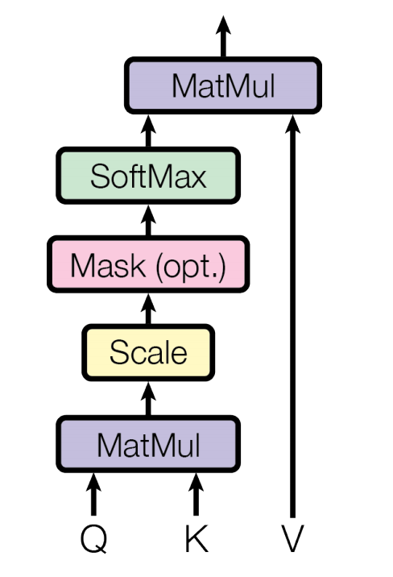
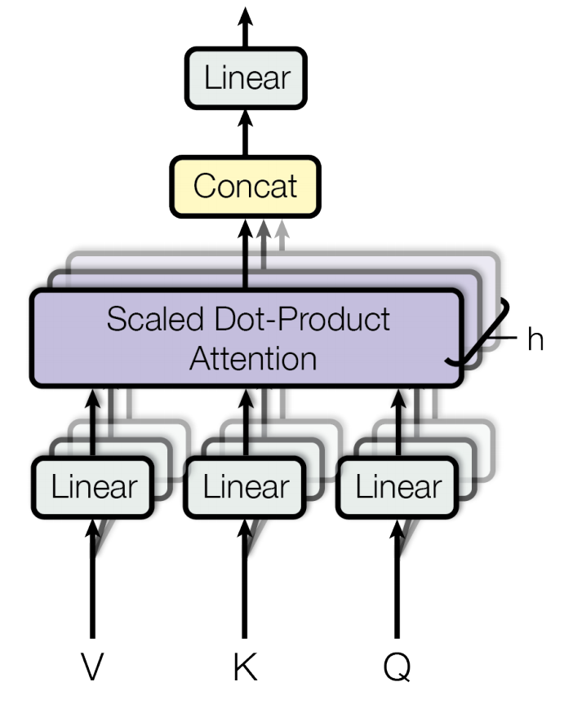
Multi-head self-attention
Scaled Dot-Product Attention
self-attention
Multiple
Heads

Slide 21
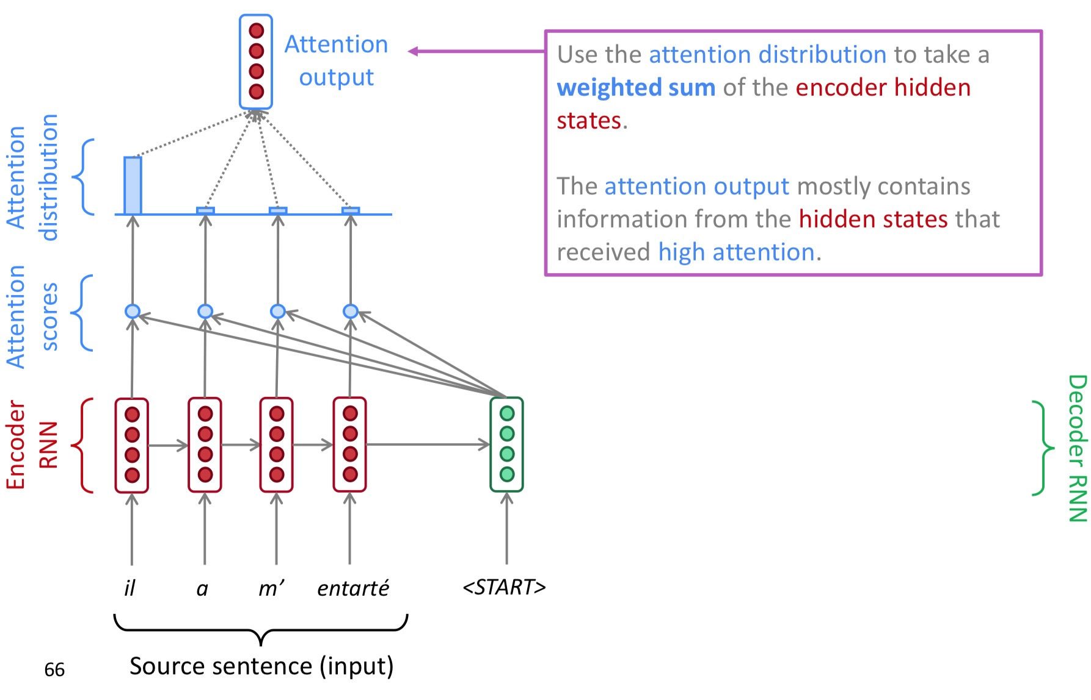
Recall: attention
(slide credit: Abigail See)

Slide 22
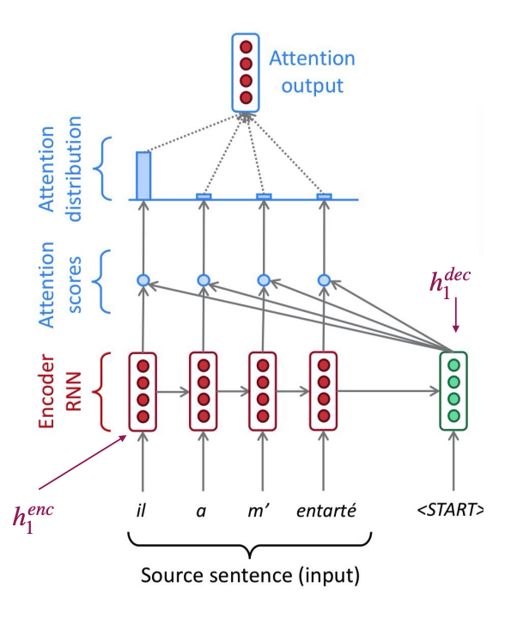
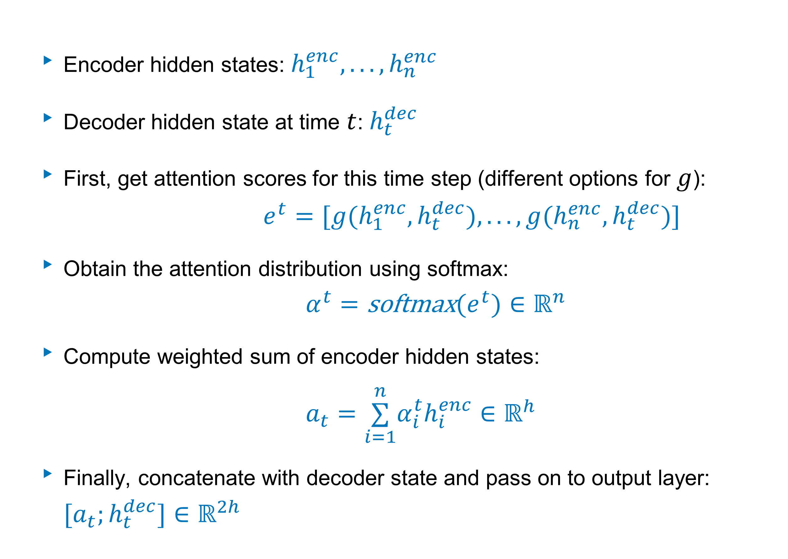
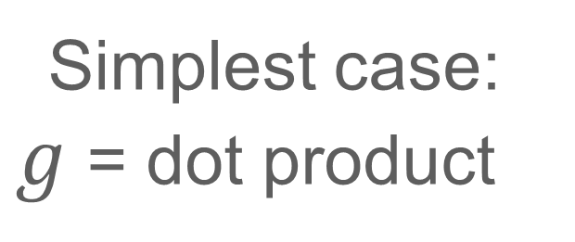
Recall: attention
Encoder hidden states: $h_{1}^{enc},...,h_{n}^{enc}$
Decoder hidden state at time $t$: $h_{t}^{dec}$
First, get attention scores for this time step (different options for $g$):
$e^{t}=[g(h_{1}^{enc},h_{t}^{dec}),...,g(h_{n}^{enc},h_{t}^{dec})]$
Obtain the attention distribution using softmax:
$α^{t}=\text{softmax}(e^{t})∈ℝ^{n}$
Compute weighted sum of encoder hidden states:
$a_{t}=\overset{n}{\underset{i=1}{∑}}α_{i}^{t}h_{i}^{enc}∈ℝ^{h}$
Finally, concatenate with decoder state and pass on to output layer: $[a_{t};h_{t}^{dec}]∈ℝ^{2h}$
Simplest case:
$g$ = dot product

Slide 23
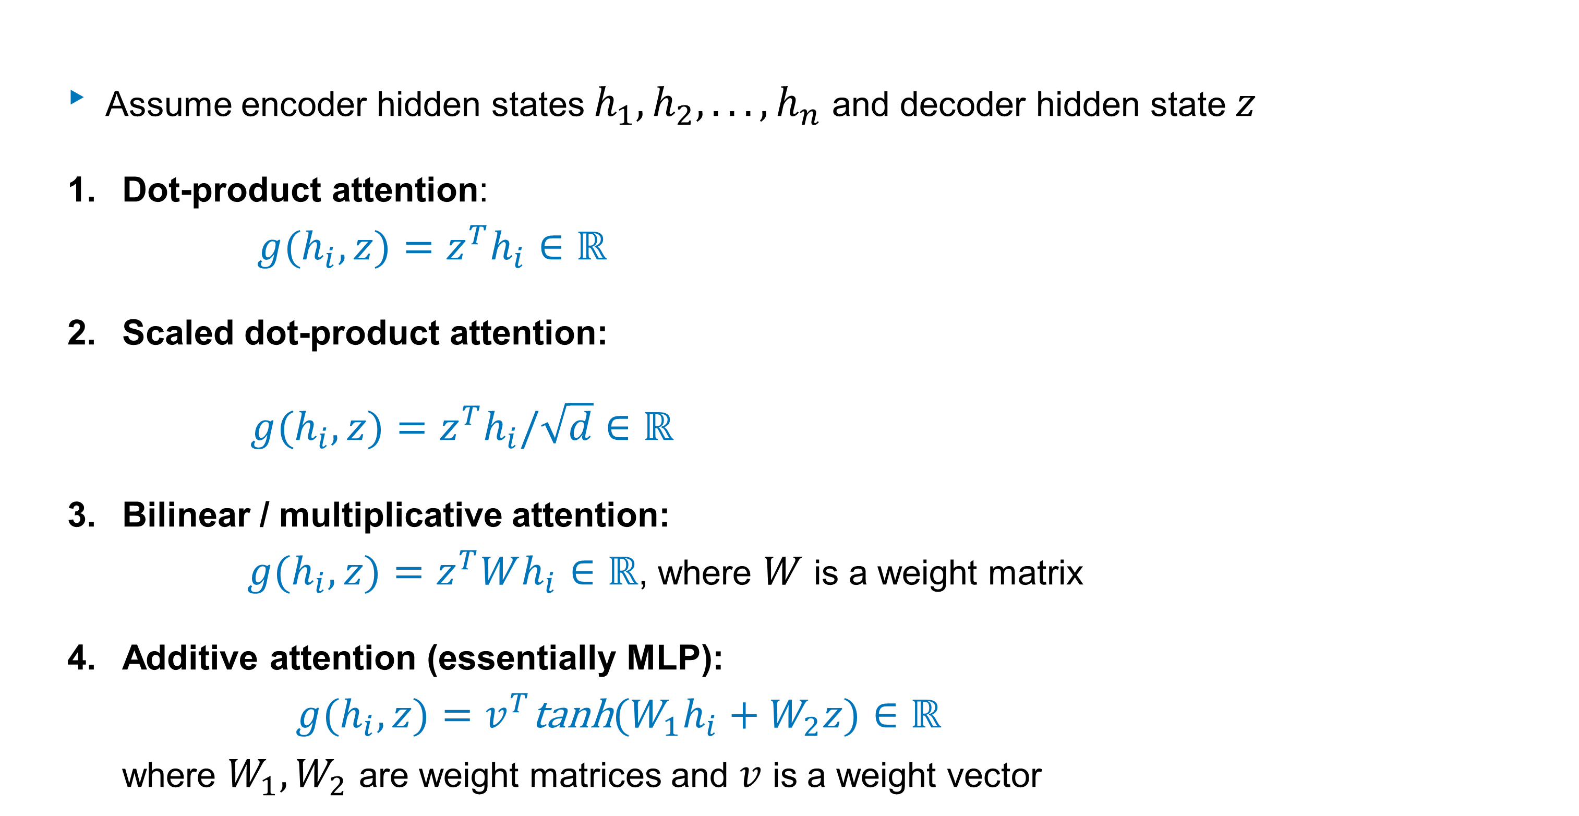
Types of attention
Assume encoder hidden states $h_{1},h_{2},...,h_{n}$ and decoder hidden state $z$
Dot-product attention:
$g(h_{i},z)=z^{T}h_{i}∈ℝ$
Scaled dot-product attention:
  $g(h_{i},z)=z^{T}h_{i}/\sqrt{d}∈ℝ$
Bilinear / multiplicative attention:
$g(h_{i},z)=z^{T}Wh_{i}∈ℝ$, where $W$ is a weight matrix
Additive attention (essentially MLP):
$g(h_{i},z)=v^{T}\text{tanh}(W_{1}h_{i}+W_{2}z)∈ℝ$
where $W_{1},W_{2}$ are weight matrices and $v$ is a weight vector
more efficient
(matrix multiplication)
Simplest (no extra parameters)
requires z and h_i to be same size
More flexible
than dot-product
(W is trainable)
Perform better for
larger dimensions
Notes:
https://lilianweng.github.io/lil-log/2018/06/24/attention-attention.html
https://towardsdatascience.com/transformer-networks-a-mathematical-explanation-why-scaling-the-dot-products-leads-to-more-stable-414f87391500

Slide 24
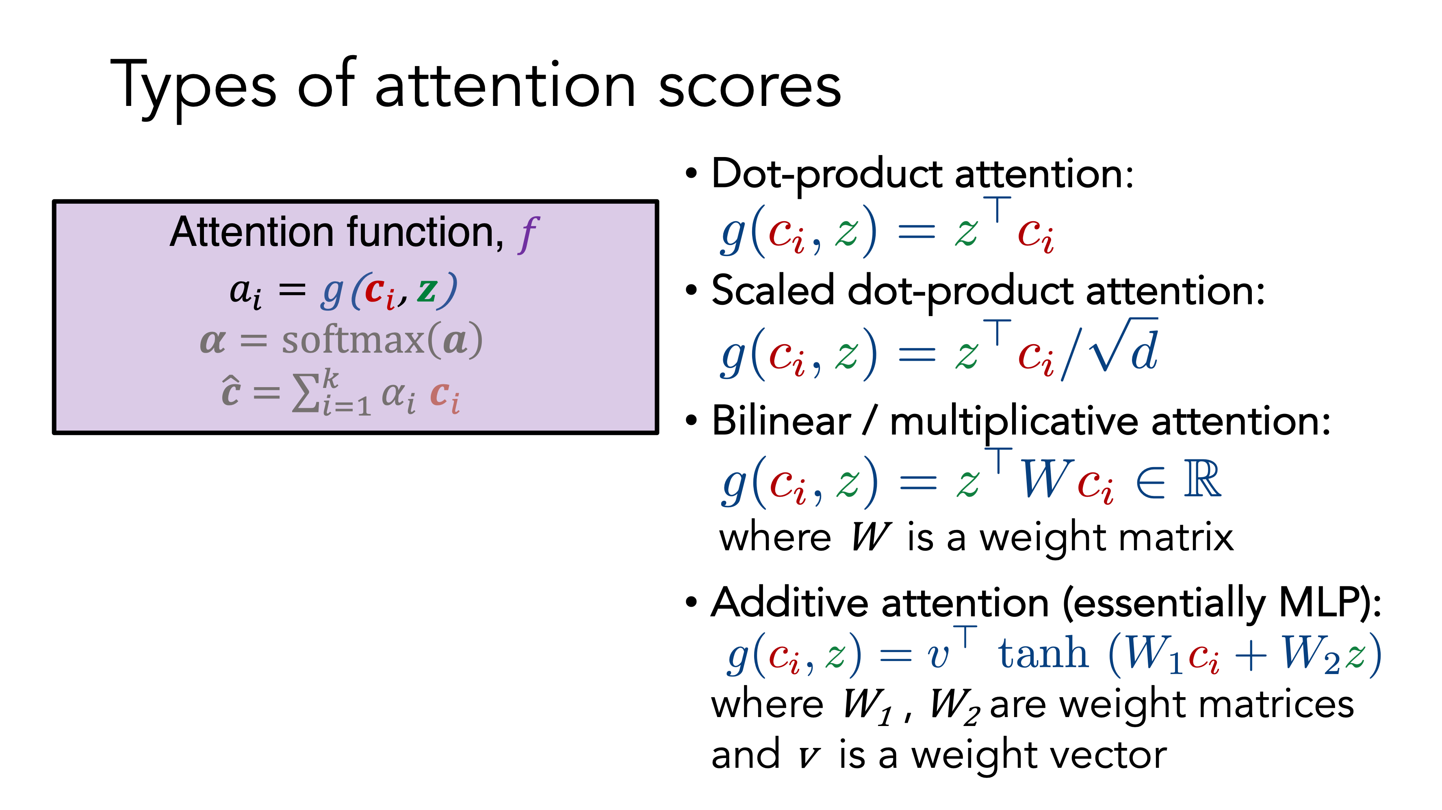

Slide 25


Slide 26


Self Attention
(also referred to as Intra-Attention)
Self-attention: let’s use each word as query and compute the attention with all the other words (other words are the keys and values)
= the word vectors themselves select each other
Notes:
Cheng et al, 2016
Vectors at the end

Slide 27

Self-Attention
Attention (correlation) with different parts of itself
Transformers: modules with scaled dot-product self-attention
https://ai.googleblog.com/2017/08/transformer-novel-neural-network.html

Slide 28
How to get key-value-query for each word?
For each word, we have vectors for the key-value-query
These vectors are created by multiplying the word embedding by trained weight matrices
Stack into matrices and compute all at once!
(figure credit: Jay Alammar
http://jalammar.github.io/illustrated-transformer/)

Slide 29
query, key, and value vectors created by multiplying learned weight matrices with embedding
Can be any kind of attention function
For transformers, this is the scaled dot-product attention
(figure credit: Jay Alammar
http://jalammar.github.io/illustrated-transformer/)
Notes:
Different weight matrices = different spaces / vectors for when the same token is treated as query, key, or value.

Slide 30

Recall: types of attention
Assume keys $k_{1},k_{2},...,k_{n}$ and query $q$
Dot-product attention (assumes equal dimensions for $k_{i}$ and $q$):
$g(k_{i},q)=q^{T}k_{i}∈ℝ$
Bilinear / multiplicative attention:
$g(k_{i},q)=k^{T}Wk_{i}∈ℝ$, where $W$ is a weight matrix
Additive attention (essentially MLP):
$g(k_{i},q)=w^{T}\text{tanh}(W_{1}k_{i}+W_{2}q)∈ℝ$
where $W_{1},W_{2}$ are weight matrices and $w$ is a weight vector
Simplest (no extra parameters)
Does not work well for large dimensions
more efficient
(matrix multiplication)
More flexible
than dot-product
(W is trainable)
Perform better for
larger dimensions

Slide 31


Scaled dot-product attention
Assume keys $k_{1},k_{2},...,k_{n}$ and query $q$
Dot-product attention (assumes equal dimensions for $k_{i}$ and $q$):
$g(k_{i},q)=q^{T}k_{i}∈ℝ$
Scaled dot-product attention:
$g(k_{i},q)=\frac{q^{T}k_{i}}{\sqrt{d}}∈ℝ$
Scale of dot product (of random vectors)
increases (proportional to $\sqrt{d}$)
as dimension gets larger
Perform poorly for large d
Softmax has small gradient
Scaled dot product will perform well
for larger dimensions
Scaling factor: d = dimension of hidden state
Notes:
https://lilianweng.github.io/lil-log/2018/06/24/attention-attention.html
Dot-product attention: when input is large, the softmax function may have an extremely small gradient, hard for efficient learning
As d gets large, the variance of the dot product increases,
some values inside the softmax get large, the softmax gets very peaked
hence its gradient gets smaller.

Slide 32



Scaled dot product attention
Attention with logit scaling
Scaling to large dimension vectors $d$
Dot product of random vectors (at initialization) grows proportional to $\sqrt{d}$
Normalize the dot products by $\sqrt{d}$ to stop this iterative scaling upwards
$$\sqrt{d}$$

Slide 33

Can be any kind of attention function
For transformers, this is the scaled dot-product attention
$z_{1}$ is the final vector of attended values for “Thinking” as the query
(figure credit: Jay Alammar
http://jalammar.github.io/illustrated-transformer/)

Slide 34









Self-attention in equations
A self-attention layer maps a sequence of input vectors $x_{1},…,x_{n}∈ℝ^{d_{1}}$ to a sequence of n vectors: $y_{1},…,y_{n}∈ℝ^{d_{2}}$
  Note: this is similar as an RNN layer and can be used to replace an RNN layer
$$q_{i}=W^{Q}x_{i},W^{Q}∈ℝ^{d_{q}×d_{1}}$$
First, construct a set of queries, keys, and values:
Second, for each $q_{i}$, compute attentions scores and attention distribution
$$k_{i}=W^{K}x_{i},W^{K}∈ℝ^{d_{k}×d_{1}}$$
$$v_{i}=W^{V}x_{i},W^{V}∈ℝ^{d_{v}×d_{1}}$$
$$α_{i,j}=\text{softmax}\left(\frac{q_{i}⋅k_{j}}{\sqrt{d_{k}}}\right)$$
Scaled dot-product
so $d_{k}=d_{q}$
Finally, compute the weighted sum:
$$y_{i}=\overset{n}{\underset{j=1}{∑}}α_{i,j}v_{j}∈ℝ^{d_{v}}$$
$$d_{v}=d_{2}$$

Slide 35

Why scaled?
Large values can cause softmax to saturate
Large dimensions, more likely to have outlier values (high variance)
Scaling helps to bring the variance down
https://apxml.com/courses/foundations-transformers-architecture/chapter-2-attention-mechanism-core-concepts/scaled-dot-product-attention

Slide 36









Self-attention: matrix notation
$$X∈ℝ^{n×d_{1}}$$
$$Q=XW^{Q},W^{Q}∈ℝ^{d_{1}×d_{q}}$$
Note: the notation on this slide are following the original paper
(= the transpose of the matrices in the previous slide)
$$K=XW^{K},W^{K}∈ℝ^{d_{1}×d_{k}}$$
Each row corresponds a token
$$n×d_{q}$$
$$d_{k}×n$$
$$V=XW^{V},W^{V}∈ℝ^{d_{1}×d_{v}}$$
$$\text{Attention}(Q,K,V)=\text{softmax}\left(\frac{QK^{T}}{\sqrt{d_{k}}}\right)V$$
$$n×d_{v}$$
Be careful to make sure
the softmax is over the correct dimension
(figure credit: Jay Alammar
http://jalammar.github.io/illustrated-transformer/)

Slide 37


Slide 38
Multi-head self-attention
Scaled Dot-Product Attention
self-attention
Multiple
Heads

Slide 39
(figure credit: Jay Alammar
http://jalammar.github.io/illustrated-gpt2/)

Slide 40
(figure credit: Jay Alammar
http://jalammar.github.io/illustrated-gpt2/)

Slide 41
(figure credit: Jay Alammar
http://jalammar.github.io/illustrated-gpt2/)

Slide 42
(figure credit: Jay Alammar
http://jalammar.github.io/illustrated-gpt2/)

Slide 43






Multi-head self-attention
One head is not expressive enough. Let’s have multiple heads!
$$\text{Multihead}(Q,K,V)=Concat({head}_{1},…,{head}_{h})W^{O}$$
$${head}_{i}=A(XW_{i}^{Q},XW_{i}^{K},XW_{i}^{V})$$
In practice, $h=8$, $d=d_{out}/h,W^{O}∈ℝ^{d_{out}×d_{out}}$
https://github.com/jessevig/bertviz
Notes:
Allamanis et al, 2016 (different heads for “copy” vs regular)

Slide 44

Why different heads?
Different heads learn to attend to different things
Emergent linguistic structure in artificial neural networks trained by self-supervision, Manning et al, PNAS 2019
Notes:
Emergent linguistic structure in artificial neural networks trained by self-supervision

Slide 45
Multiple heads
Multiple (different) representations for each query, key, and values
Different weight matrices —> different vectors
Different ways for the words to interact with each other
(figure credit: Jay Alammar
http://jalammar.github.io/illustrated-transformer/)

Slide 46





Multi-head attention
$$\text{Multihead}(Q,K,V)=Concat({head}_{1},…,{head}_{h})W^{O}$$
$${head}_{i}=A(XW_{i}^{Q},XW_{i}^{K},XW_{i}^{V})$$
In practice, we use a reduced dimension for each head.
The total computational cost is similar to that of single-head attention with full dimensionality
$$W_{i}^{Q}∈ℝ^{d_{1}×d_{q}},W_{i}^{K}∈ℝ^{d_{1}×d_{k}},W_{i}^{V}∈ℝ^{d_{1}×d_{v}}$$
$$d_{q}=d_{k}=d_{v}=d/h$$
$d$ = hidden size, $h$ = # of heads
$$W^{O}∈ℝ^{d×d_{2}}$$
If we stack multiple layers, usually $d_{1}=d_{2}=d$

Slide 47




Summary: Multi-head Self Attention
Attention: a query $q$ and a set of key-value $(k_{i},v_{i})$ pairs to an output
Dot-product attention:
$$A(q,K,V)=\underset{i}{∑}\frac{e^{q⋅k_{i}}}{\sum_{j}{e^{q⋅k_{j}}}}v_{i}$$
$$K,V∈ℝ^{n×d},q∈ℝ^{d}$$
If we have multiple queries:
$$A(Q,K,V)=softmax(QK^{⊺})V$$
$$Q∈ℝ^{n_{Q}×d},K,V∈ℝ^{n×d}$$
Self-attention: let’s use each word as query and compute the attention with all the other words
= the word vectors themselves select each other

Slide 48






Summary: Multi-head Self Attention
Scaled Dot-Product Attention:
$$A(Q,K,V)=softmax(\frac{QK^{⊺}}{\sqrt{d}})V$$
Input: $X∈ℝ^{n×d_{in}}$
$$A(XW^{Q},XW^{K},XW^{V})∈ℝ^{n×d}$$
$$W^{Q},W^{K},W^{V}∈ℝ^{d_{in}×d}$$
Multi-head attention: using more than one head is always useful..
$$A(Q,K,V)=Concat({head}_{1},…,{head}_{h})W^{O}$$
$${head}_{i}=A(XW_{i}^{Q},XW_{i}^{K},XW_{i}^{V})$$
In practice, $h=8$, $d=d_{out}/h,W^{O}=d_{out}×d_{out}$

Slide 49
Transformer Encoder
Each Transformer block has two sub-layers
  Multi-head attention
  2-layer feedforward NN (with ReLU)
  Without FFNN: No non-linearity!
Notes:
There is no element wise nonlinearities in self attention; stacking more self-attention layers just reaverages value vectors

Slide 50

Adding nonlinearities

Slide 51

Transformer Encoder
residual connection
Each Transformer block has two sub-layers
  Multi-head attention
  2-layer feedforward NN (with ReLU)
Each sublayer has a residual connection and a layer normalization
  $LayerNorm(x+SubLayer(x))$
(He et al, 2016): Residual connections
(Ba et al, 2016): Layer Normalization
Notes:
There is no element wise nonlinearities in self attention; stacking more self-attention layers just reaverages value vectors

Slide 52


Residual Connections
He+ 2015 https://arxiv.org/abs/1512.03385
Add input of a layer to output of that layer
$z^{ℓ+1}=f(z^{ℓ})+z^{ℓ}$
Local gradient is 1 for the identity function
Easier to learn the difference from the identity function than to learn the function from scratch.
https://arxiv.org/pdf/1712.09913.pdf

Slide 53

Residual connections and Layer Normalization
LayerNorm
  changes input features to have mean 0 and variance 1 per layer.
  Adds two more parameters
  For more stable and efficient training
(figure credit: Jay Alammar
http://jalammar.github.io/illustrated-transformer/)
(Ba et al, 2016): Layer Normalization
Notes:
LayerNorm: originally proposed for RNNs for handling varying sequence length
Parameters: scale and shift: adaptive gain (g) and bias (b))
Norm across the hidden units
All hidden units in a layer has the same normalization.
BatchNorms: constraints on batch size (can’t be too small)
Handle "internal covariate shift” (whatever that means)
https://mlexplained.com/2018/11/30/an-overview-of-normalization-methods-in-deep-learning/

Slide 54

Add & Norm
Residual Connections and Layer Norm
Combine residual connection and layer norm into a single "Add & Norm" component
Two choices:
  Pre-norm (input): $z^{ℓ+1}=f(\text{LN}(z^{ℓ}))+z^{ℓ}$
  Res-Post-norm (output): $z^{ℓ+1}=\text{LN}(f(z^{ℓ}))+z^{ℓ}$
  Post-norm: $z^{ℓ+1}=\text{LN}(f(z^{ℓ})+z^{ℓ})$
Pre-norm leads to faster training.
https://arxiv.org/abs/2002.04745
https://arxiv.org/abs/2111.09883
https://arxiv.org/abs/1706.03762

Slide 55

Transformer Encoder
Each Transformer block has two sub-layers
  Multi-head attention
  2-layer feedforward NN (with ReLU)
Each sublayer has a residual connection and a layer normalization
  $LayerNorm(x+SubLayer(x))$
Input layer has a positional encoding
Necessary for the model to
know the position of the token
(He et al, 2016): Residual connections
(Ba et al, 2016): Layer Normalization
Notes:
Unlike a RNN where we have implicit modeling of the sequence, the transformer (so far) no longer has any idea of the position of the input in the sentence.

Slide 56



Positional encoding
t = position
d = embedding dimension
i = embedding index (0 to d-1)
Sine
Cosine
Notes:
Experimented with learned positional embeddings: almost identical performance as this sinusoidal embeddings
Thus use this embedding since it will be able to handle length not seen during training
Geometric progression
P(pos+k) can be represented as a linear function of P(pos). Improve by having relative position embeddings
https://kazemnejad.com/blog/transformer_architecture_positional_encoding/

Slide 57
Positional encoding
+1
Position t
t = position
d = embedding dimension
i = embedding index (0 to d-1)
-1
Embedding index i
Notes:
Experimented with learned positional embeddings: almost identical performance as this sinusoidal embeddings
Thus use this embedding since it will be able to handle length not seen during training
Geometric progression
P(pos+k) can be represented as a linear function of P(pos). Improve by having relative position embeddings
https://kazemnejad.com/blog/transformer_architecture_positional_encoding/

Slide 58



Positional encoding
Dot product of positions
Fixed absolute encoding
Words that are closer to each other have higher dot product (relative attention is high)
Can scale to long sequences

Slide 59
Transformer encoder
original
Transformer
Non-recurrent,
deep model with
attention
Each Transformer block has two sub-layers
  Multi-head attention
  2-layer feedforward NN (with ReLU)
Each sublayer has a residual connection and a layer normalization
  $LayerNorm(x+SubLayer(x))$
Input layer has a positional encoding
Input embedding is byte pair encoding (BPE)
BERT_base: 12 layers, 12 heads, hidden size = 768, 110M parameters
BERT_large: 24 layers, 16 heads, hidden size = 1024, 340M parameters
(He et al, 2016): Residual connections
(Ba et al, 2016): Layer Normalization
Notes:
Non-recurrent sequence model
Deep model with attention-based transformer blocks

Slide 60


Transformer decoder
Encoder-Decoder Attention, where queries come from previous decoder layer and keys and values come from output of encoder
Masked decoder self-attention on previously generated outputs
also 6 layers (in original paper)
(figure credit: Jay Alammar
http://jalammar.github.io/illustrated-gpt2/)

Slide 61
Subword modeling

Slide 62
Importance of subword modeling
Methods for subword modeling
  Byte Pair Encoding
  Wordpiece / sentence piece
Character-level to word-level
Character-level embeddings
  FastText
Notes:
http://www.wildml.com/2015/11/understanding-convolutional-neural-networks-for-nlp/
Understanding Convolutional Neural Networks for Text Classification
Jacovi et al 2018
https://www.aclweb.org/anthology/W18-5408.pdf
An Empirical Evaluation of Generic Convolutional and Recurrent Networks for Sequence Modeling
Bai, Kolter, Koltun 2018
https://arxiv.org/pdf/1803.01271.pdf
Comparative Study of CNN and RNN for Natural Language Processing
Yin et al 2017
https://arxiv.org/pdf/1702.01923.pdf

Slide 63
Subword modeling
Why subword modeling?
  Captures morphology
  Helps with OOV words
    New words, spelling variants, misspellings, and noisy text
Ways of incorporating subword modeling
  Use subwords (word-pieces) as tokens
  Hybrid architecture where part of the word embeddings come from subword modeling
Used in most SOTA NLP methods
  Character CNNs in ELMo
  BPE (Byte Pair Encoding) in original Transformer paper
  Wordpiece / sentence piece (in BERT)
Notes:
http://www.wildml.com/2015/11/understanding-convolutional-neural-networks-for-nlp/
Understanding Convolutional Neural Networks for Text Classification
Jacovi et al 2018
https://www.aclweb.org/anthology/W18-5408.pdf
An Empirical Evaluation of Generic Convolutional and Recurrent Networks for Sequence Modeling
Bai, Kolter, Koltun 2018
https://arxiv.org/pdf/1803.01271.pdf
Comparative Study of CNN and RNN for Natural Language Processing
Yin et al 2017
https://arxiv.org/pdf/1702.01923.pdf

Slide 64

Linguistic Basis
Morphology

Slide 65
Used in recent SOTA models
Elmo
BERT
All modern LLMs
Helps with OOV words
New words
Spelling variants
Misspellings / noisy text

Slide 66


NN over characters to build word representations
Convolution over characters to generate word embeddings
Same objective as word2vec but with characters
Bi-directional LSTM to compute embedding
Fixed window of word embeddings used for PoS tagging
Learning Character-level Representations for Part-of-Speech Tagging (Dos Santos and Zadrozny 2014)
Char2vec: A joint model for word embedding and word morphology (Cao and Rei, 2016)

Slide 67
Ways to incorporate sub-words
Same architecture as for word-level models:
  Use smaller units (‘’word pieces’’)
Hybrid architecture
  Character into words
  Main architecture still work with words

Slide 68
Byte Pair Encoding
Originally a compression algorithm
  Bottom up clustering
  Most frequent byte pair -> a new byte
  For words, replace bytes with character ngrams
Automatically build vocabulary
  Vocabulary is pieces of words (or character ngrams)
  Deterministic algorithm that finds the common longest pieces of words to use in vocabulary
Notes:
https://www.thoughtvector.io/blog/subword-tokenization/
https://mlexplained.com/2019/11/06/a-deep-dive-into-the-wonderful-world-of-preprocessing-in-nlp/

Slide 69
Byte Pair Encoding
count | bigram
5 + 2 | l o
5 + 2 | o w
2 + 6 | w e
2 | e r
6 | n e
6 | e w
6 + 3 | e s
6 + 3 | s t
3 | w i
3 | i d
3 | d e
A word (character ngram) segmentation algorithm
  Start with a vocabulary of characters
  Take most frequent ngram pair -> add the new ngram the to vocabulary
Dictionary
Vocabulary
l, o, w, e, r, n, w, s, t, i, d
5 l o w
2 l o w e r
6 n e w e s t
3 w i d e s t
Start with all characters in vocabulary

Slide 70
Byte Pair Encoding
count | bigram
5 + 2 | l o
5 + 2 | o w
2 | w e
2 | e r
6 | n e
6 | e w
6 | w es
6 + 3 | es t
3 | w i
3 | i d
3 | d es
A word (character ngram) segmentation algorithm
  Start with a vocabulary of characters
  Take most frequent ngram pair -> add the new ngram the to vocabulary
Dictionary
Vocabulary
l, o, w, e, r, n, w, s, t, i, d, es
5 l o w
2 l o w e r
6 n e w es t
3 w i d es t
Add a pair (e,s) with frequency 9

Slide 71
Byte Pair Encoding
count | bigram
5 + 2 | l o
5 + 2 | o w
2 | w e
2 | e r
6 | n e
6 | e w
6 | w est
3 | w i
3 | i d
3 | d est
A word (character ngram) segmentation algorithm
  Start with a vocabulary of characters
  Take most frequent ngram pair -> add the new ngram the to vocabulary
Dictionary
Vocabulary
l, o, w, e, r, n, w, s, t, i, d, es, est
5 l o w
2 l o w e r
6 n e w est
3 w i d est
Add a pair (es,t) with frequency 9

Slide 72
Byte Pair Encoding
count | bigram
5 + 2 | lo w
2 | w e
2 | e r
6 | n e
6 | e w
6 | w est
3 | w i
3 | i d
3 | d est
A word (character ngram) segmentation algorithm
  Start with a vocabulary of characters
  Take most frequent ngram pair -> add the new ngram the to vocabulary
Dictionary
Vocabulary
l, o, w, e, r, n, w, s, t, i, d, es, est, lo
5 lo w
2 lo w e r
6 n e w est
3 w i d est
Add a pair (l,o) with frequency 7

Slide 73
Byte Pair Encoding
When to stop
  Have a target vocabulary size and stop when you reach it
Deterministic, common longest piece segmentation of words
Segmentation is only within words already identified by some prior tokenizers
Automatically decide vocabulary to use (vocabulary is pieces of words - character ngrams)

Slide 74
Wordpiece/Sentencepiece
Used in Google NMT
  V1: wordpiece
  V2: sentencepiece
Difference way to select what ngram to add
  Choose n-gram that maximally reduces perplexity
  Greedy approximation to maximizing the language model log likelihood
Japanese and Korean Voice Search [Schuster and Nakajima 2012]

Slide 75
Wordpiece/Sentencepiece
Used in Google NMT
  V1: wordpiece
  V2: sentencepiece
Variant of wordpiece model is used in BERT
  Common words are in vocabulary: at, Fairfax, 1910s
  Other words built from workpieces: Hypatia = h ##yp ##ati ##a

Slide 76
Wordpiece/Sentencepiece
Used in Google NMT
  V1: wordpiece
  V2: sentencepiece
only tokenizes inside words
Also accommodates Unigram
works directly on raw text
(use special token _ for whitespace)
https://github.com/google/sentencepiece
https://arxiv.org/pdf/1808.06226 [Kudo and Richardson 2018]

Slide 77




Unigram
Finds vocabulary $V$ that gives the maximum likelihood for a given vocabulary size. For given segmentation $T=(x_{1},...x_{M})$ for input $X$, likelihood is given by
Need to estimate vocabulary $V$, possible segmentations, and token probabilities $p(x_{i})$ jointly: use EM
With vocabulary $V$ and input $X$, can get optimal segmentation using Viterbi, or output multiple segmentations with their probabilities (with sampling with subword regularization).
Unigram Models for Subword Segmentation [Kudo 2018]

Slide 78

Unigram algorithm
Start with heuristic seed vocabulary $V$ (that is sufficiently large)
  For example: all characters + frequent substrings (can also run BPE)
Repeat until $|V|$ reaches the desired vocabulary size
  Given $V$, optimize likelihood of text data ($P(X)$) and tokenization $T$ using EM algorithm
  Compute $loss(x_{i})$ for each token $x_{i}∈V$ where loss is how much the likelihood is to be reduced if token $x_{i}$ is removed
  Sort by loss and keep top 80% tokens in V (note: always keep single character subwords to avoid OOV)

Slide 79

Do we need all these heads?
3 types of attention: Enc-Enc, Enc-Dec, Dec-Dec
6 layers, 16 heads each layer for each type
Can we prune away some of the heads of a trained model during test time?
Are Sixteen Heads Really Better than One?
Michel, Levy, and Neubig, NeurIPS 2019
Notes:
288 heads in total

Slide 80

Do we need all these heads?
3 types of attention: Enc-Enc, Enc-Dec, Dec-Dec
6 layers, 16 heads each layer for each type
Can we train a good MT model with less heads?
Are Sixteen Heads Really Better than One?
Michel, Levy, and Neubig, NeurIPS 2019

Slide 81


RNNs vs Transformers
Transformer layer 3
Transformer layer 2
Transformer layer 1
the
movie
was
terribly
exciting
!
RNN
Transformer

Slide 82



Useful Resources
Pytorch (https://pytorch.org/docs/stable/nn.html#transformer-layers)
nn.Transformer:
https://github.com/huggingface/transformers
nn.TransformerEncoder:
Other details
Learning rate with warmup and decay
Label smoothing
The Annotated Transformer:
http://nlp.seas.harvard.edu/2018/04/03/attention.html
A Jupyter notebook which explains how Transformer works line by line in PyTorch!

Slide 83
Useful resources
Illustrated transformer: https://jalammar.github.io/illustrated-transformer/
  1.5 hour course on transformer-based LLMs
3Blue1Brown: https://www.youtube.com/watch?v=eMlx5fFNoYc
With code: https://d2l.ai/chapter_attention-mechanisms-and-transformers/transformer.html

Slide 84

Perfomance on machine translation
Attention is all you need
Vaswani et al, NeurIPS 2017

Slide 85




Transformer Pros and Cons
Pros
  Easier to capture dependencies: we draw attention between every pair of words
  Easier to parallelize (matrix operations)
Cons
  Quadratic computation in self-attention
    Can become very slow when the sequence length is large
  Are these positional representations enough to capture positional information?
$$Q=XW^{Q},W^{Q}∈ℝ^{d_{1}×d_{q}}$$
$$K=XW^{K},W^{K}∈ℝ^{d_{1}×d_{k}}$$
$$V=XW^{V},W^{V}∈ℝ^{d_{1}×d_{v}}$$

Slide 86



Transformers for pretraining
Self-supervised Transformer based models shattered language understanding benchmarks in NLP in 2018.
Trained on large text corpus with self-supervised objectives and then transferred.
Encoder only
Decoder only
Encoder-Decoder
Masked language models
Bidirectional context
BERT + variants (e.g. RoBERTa)
Language models
Can’t condition on future words, good for generation
GPT, LLaMa, PaLM
Combine benefits of both
Original Transformer, UniLM, BART, T5
Slide adapted from: Stanford CS224n, John Hewitt

